Slide 1

EECS E6893 Big Data Analytics HW2: Classification and Twitter data analysis with Spark Streaming
Yunhang Lin, yl4860@columbia.edu
Rui Chu, rc3414@columbia.edu
10/07/2022

Slide 2
Agenda
Binary classification with Spark MLlib
Logistic Regression
Twitter data analysis with Spark Streaming
LDA

Slide 3
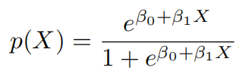
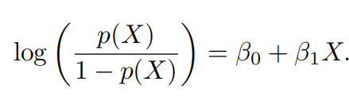
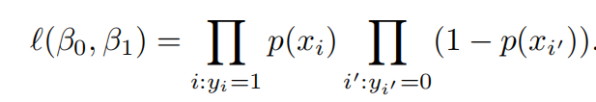
Logistic Regression
Logistic Function:
Likelihood Function:

Slide 4
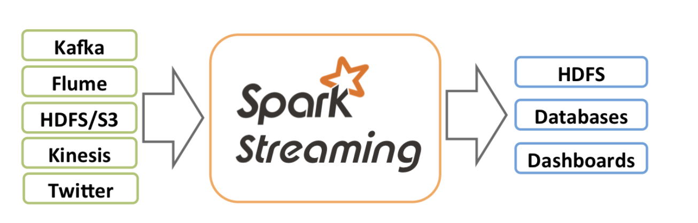
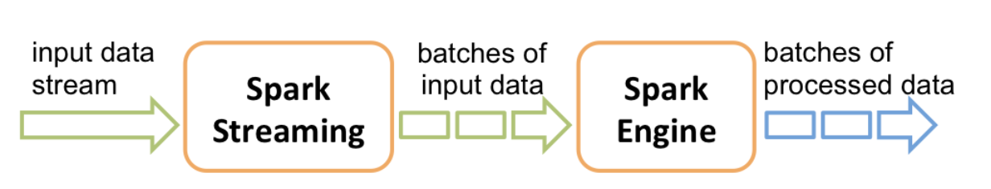
Spark Streaming
https://spark.apache.org/docs/latest/streaming-programming-guide.html

Slide 5
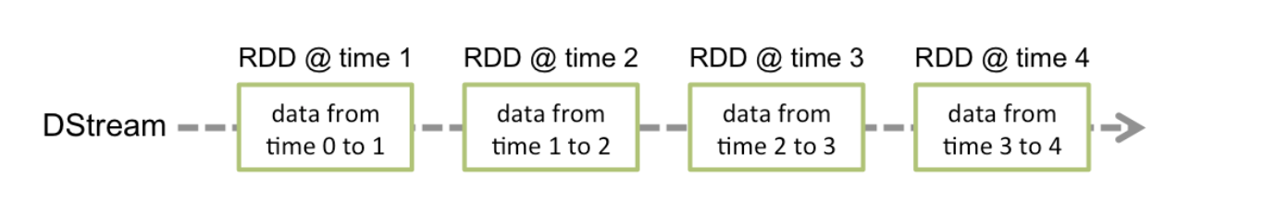
Dstream
A basic abstraction provided by Spark Streaming
Represents a continuous stream of data
Contains a continuous series of RDDs at different time

Slide 6
Architecture
Spark Context
Spark Streaming
request
Socket
request
Twitter API
data
data
Put streaming data
Write
data
Read data
Google
Storage
BigQuery

Slide 7
LDA (Latent Dirichlet allocation)
A topic model.
A three-layer Bayesian probability model, including a three-layer structure of words, topics, and documents.
It can be used to generate a document, and identify themes in a large-scale document.

Slide 8
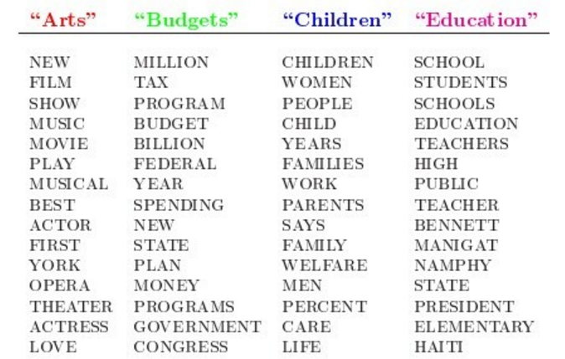
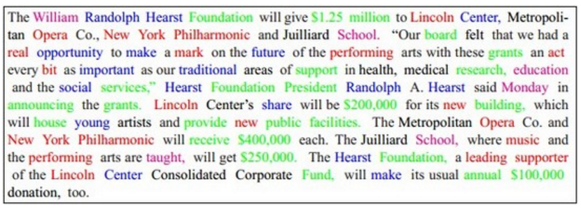
LDA (Latent Dirichlet allocation)

Slide 9
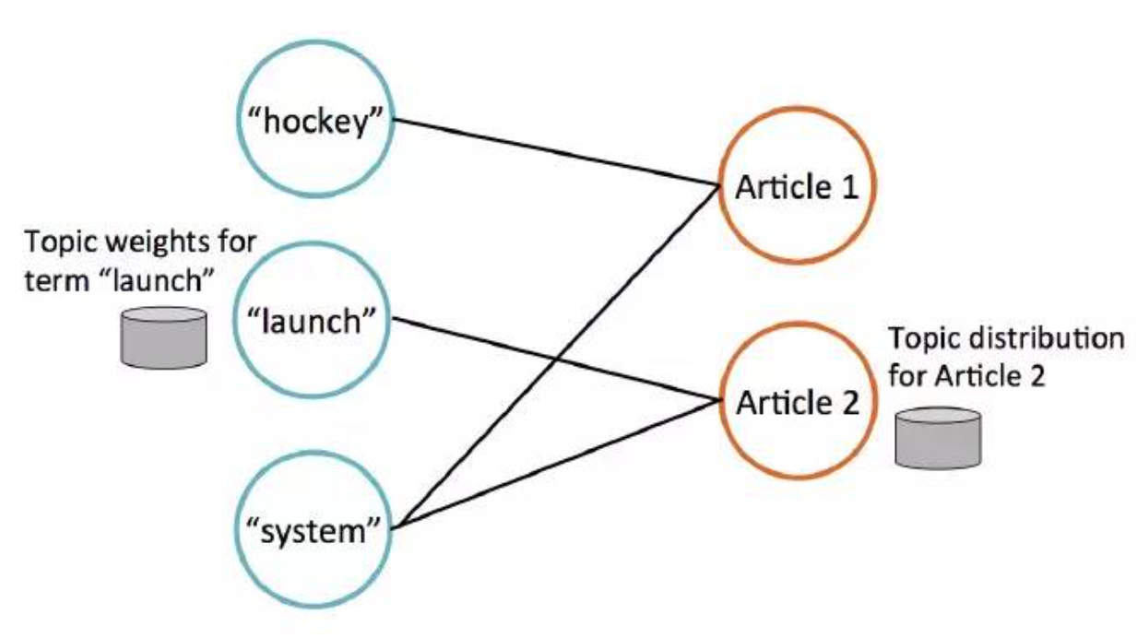
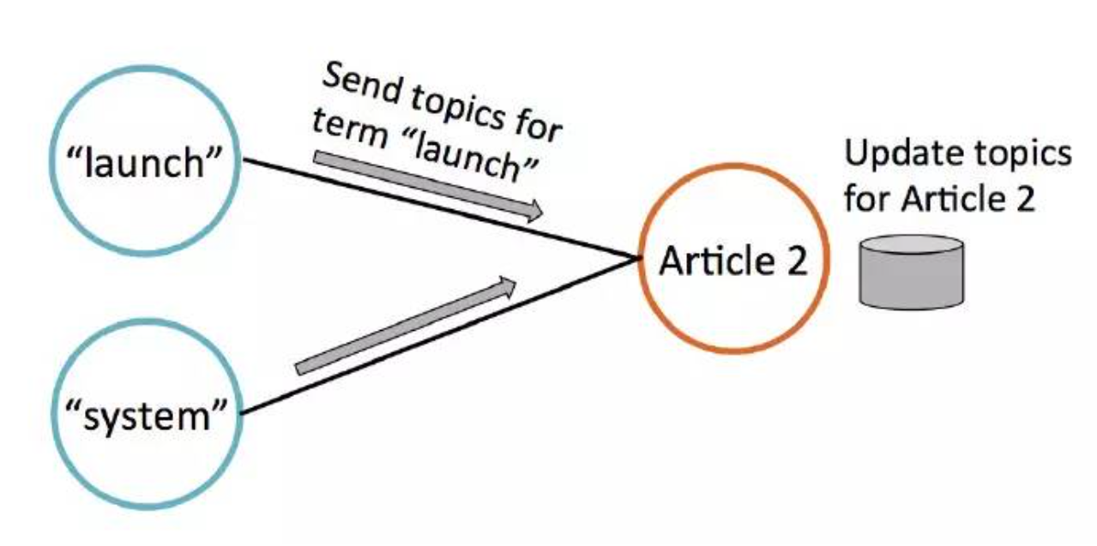
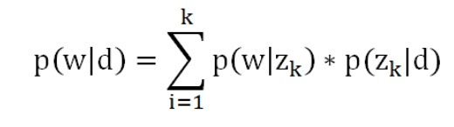
LDA (Latent Dirichlet allocation)
The left side is the word node, and the right side is the document node. Each word node stores some weight values to indicate which topic the word is related to; similarly, each article node stores an estimate of the topic discussed in the current article.
d is the document, w is the word, z is the topic, and k is the number of topics.

Slide 10
HW2

Slide 11
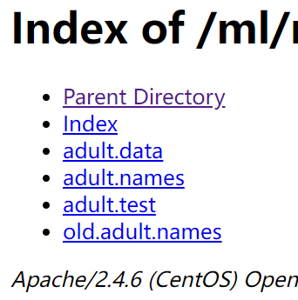

HW2 Part I Binary classification with Spark MLlib
Adult dataset​ from UCI Machine Learning Repository
Given information of a person, predict if the person could earn > 50k per year

Slide 12
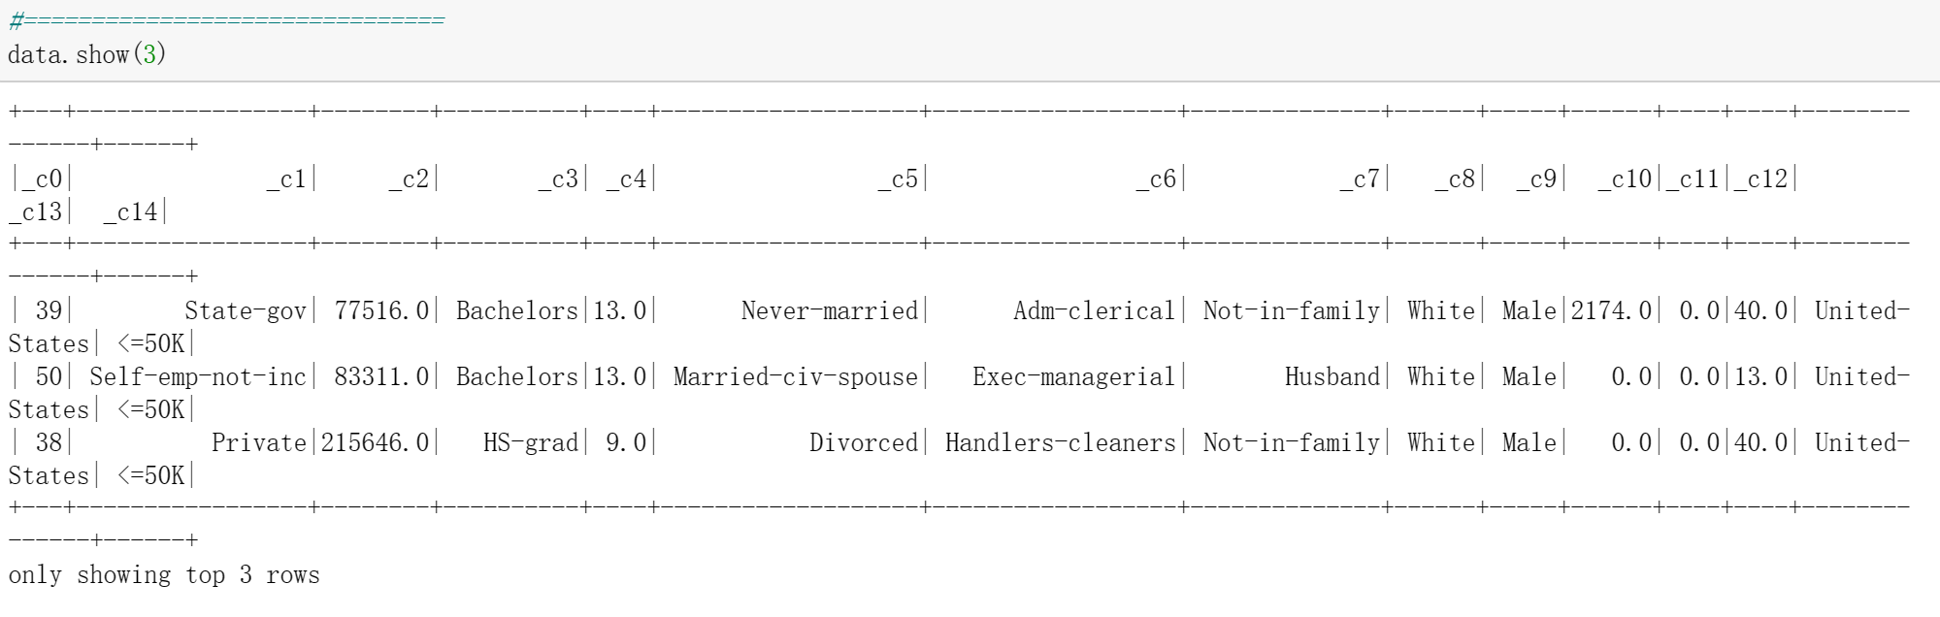
HW2 Part I Binary classification with Spark MLlib
Workflow
Data loading: load data into Dataframe
Spark Dataframe Guide: https://spark.apache.org/docs/latest/sql-getting-started.html

Slide 13
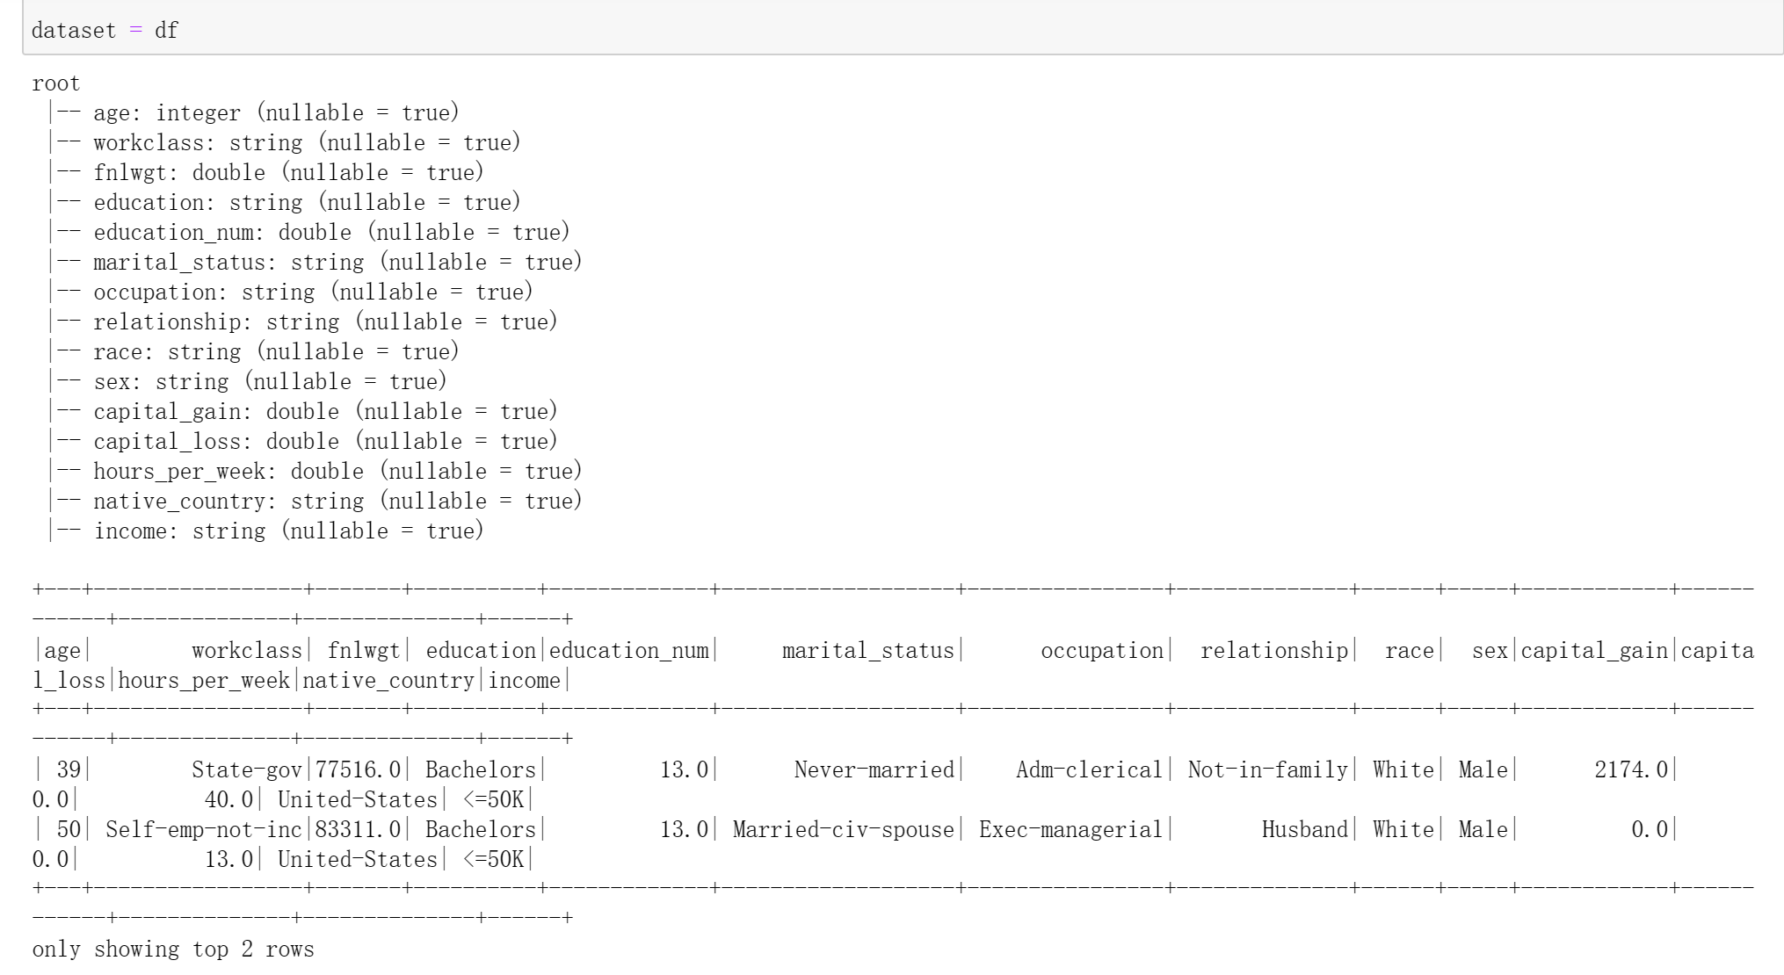
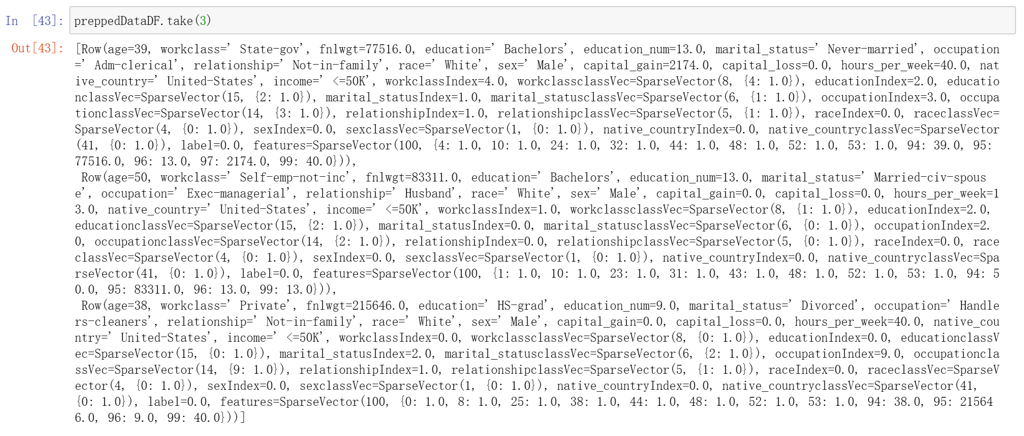
HW2 Part I Binary classification with Spark MLlib
Workflow
Data preprocessing: Convert the categorical variables into numeric variables with ​ML Pipelines​ and Feature Transformers​

Slide 14
HW2 Part I Binary classification with Spark MLlib
Workflow
Modelling：
Logistic Regression
KNN
Random Forest
Naive Bayes
Decision Tree
Gradient Boosting Trees
Multi-layer perceptron
Linear Support Vector Machine
One-vs-Rest
https://spark.apache.org/docs/latest/ml-classification-regression.html

Slide 15
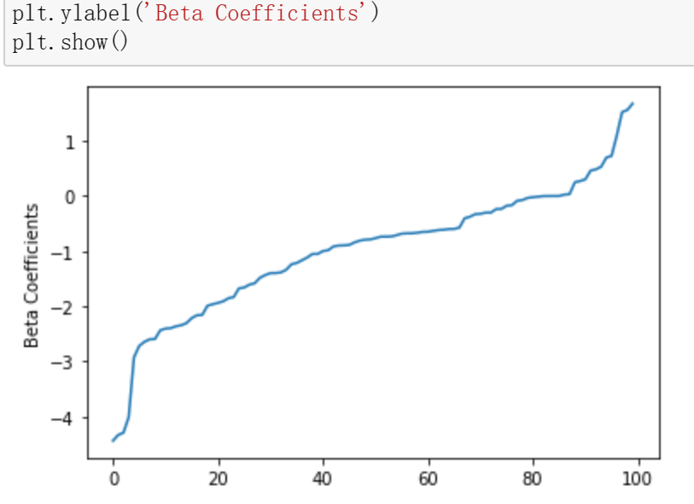
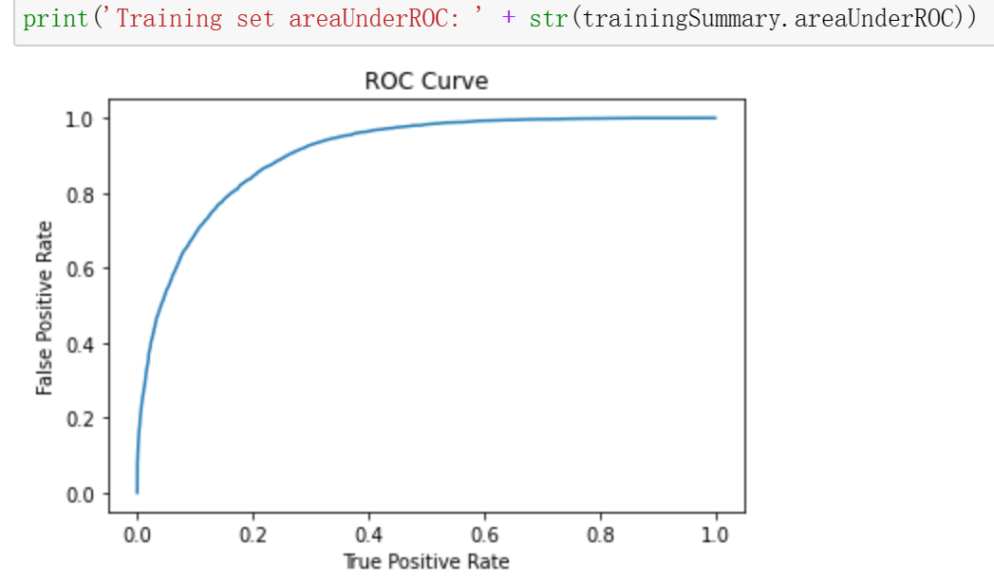
HW2 Part I Binary classification with Spark MLlib
Workflow
Evaluation (Logistic Regression)

Slide 16
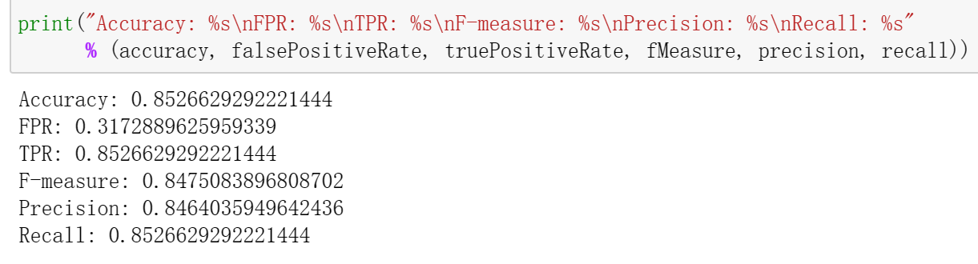
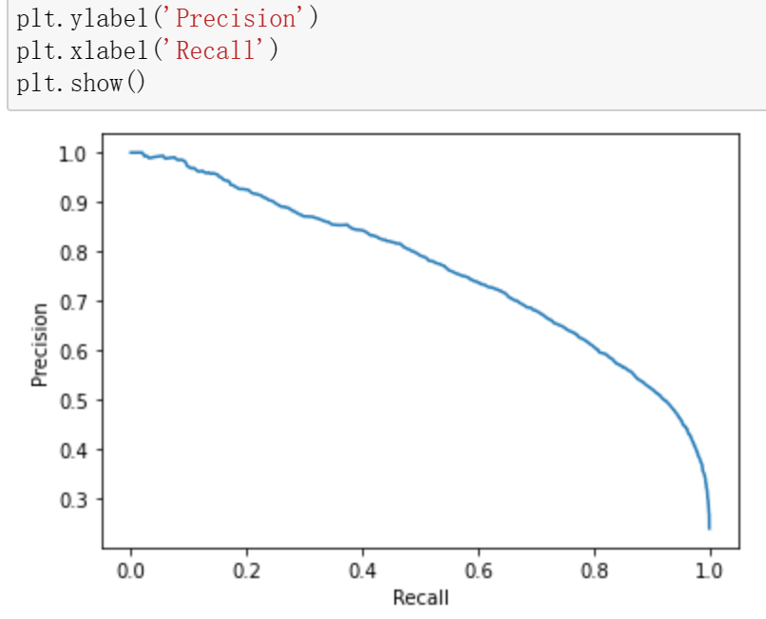
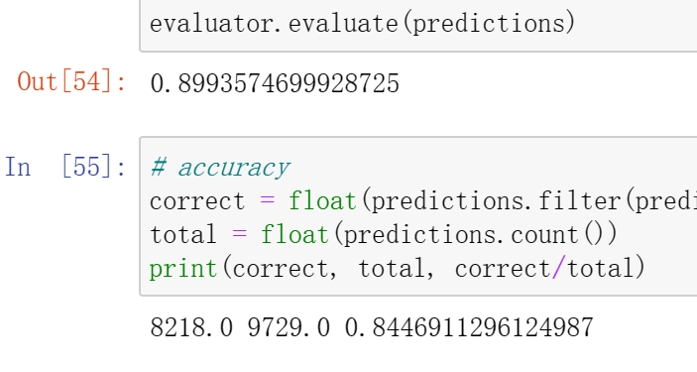
HW2 Part I Binary classification with Spark MLlib
Workflow
Evaluation (Logistic Regression)

Slide 17
HW2 Part II Twitter Data Analysis
Calculate the accumulated hashtags count sum for 600 seconds and sort it by descending order of the count.
Filter the chosen 5 words and calculate the appearance frequency of them in 60 seconds for every 60 seconds (no overlap).
Save results to google BigQuery.
Use LDA to do Clustering to your streaming, see the topic distribution.

Slide 18
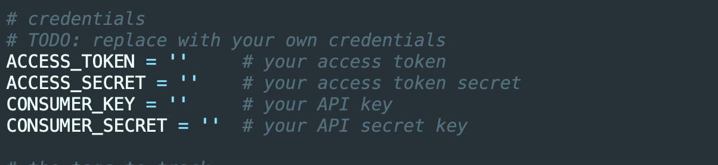
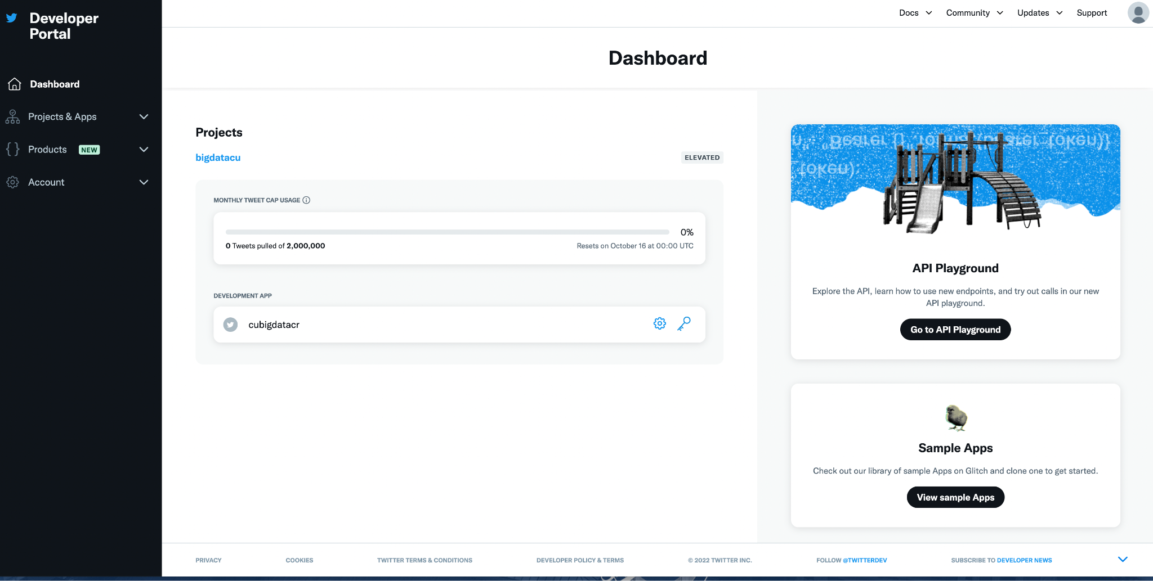
Register on Twitter Apps (Do this ASAP)
https://developer.twitter.com/en/apply-for-access.html

Slide 19
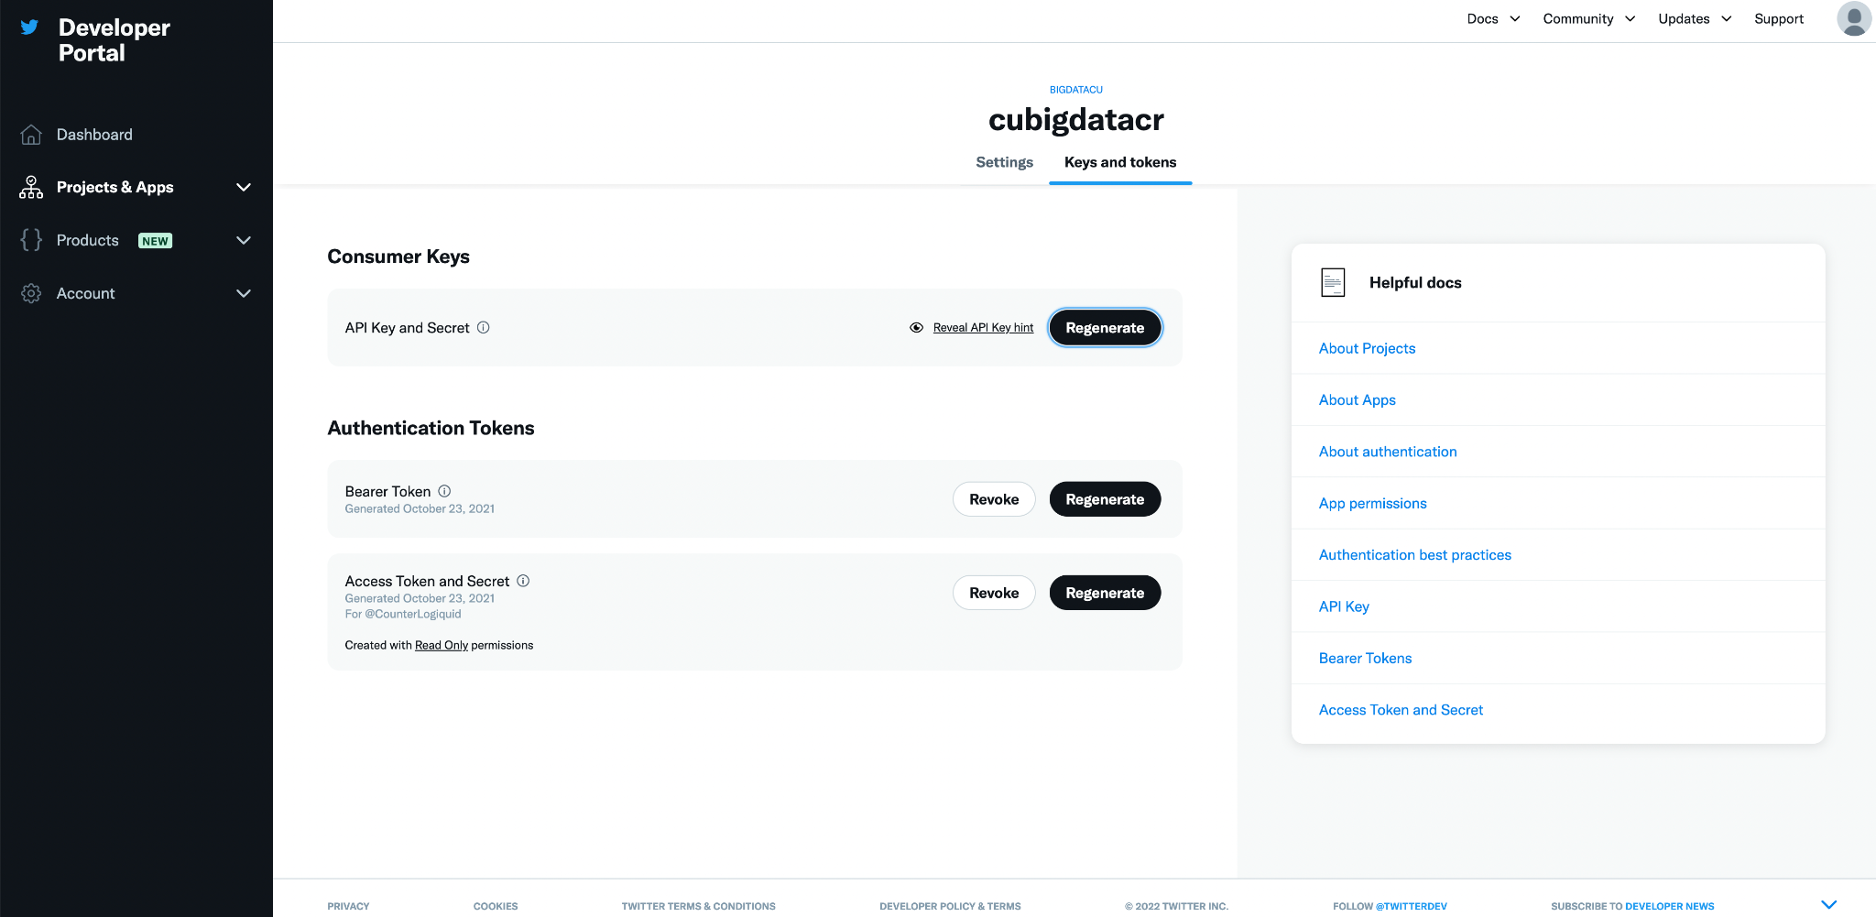

Slide 20
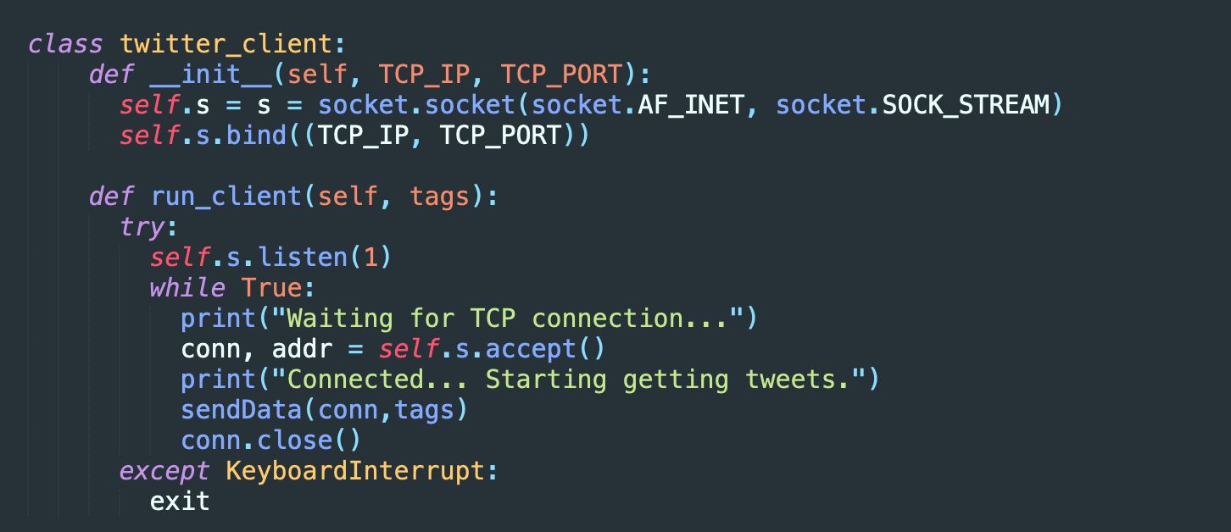
Socket
Use TCP, need to provide IP and Port for client to connect

Slide 21
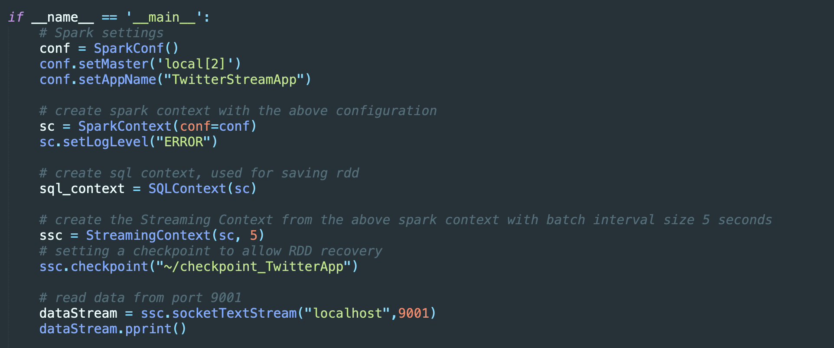
Spark Streaming
Create a local StreamingContext with two working thread and batch interval of 5 second.
Create stream from TCP socket IP localhost and Port 9001

Slide 22
Spark Streaming
Start streaming context
Stop after 600 seconds (You can set STREAMTIME to a smaller value at first)
Save results to BigQuery

Slide 23
Start streaming
Run twitterHTTPClient.py
Run sparkStreaming.py
You can test sparkStreaming.py multiple times and leave twitterHTTPClient.py running
Stop twitterHTTPClient.py (on job page of the cluster or use gcloud command)

Slide 24
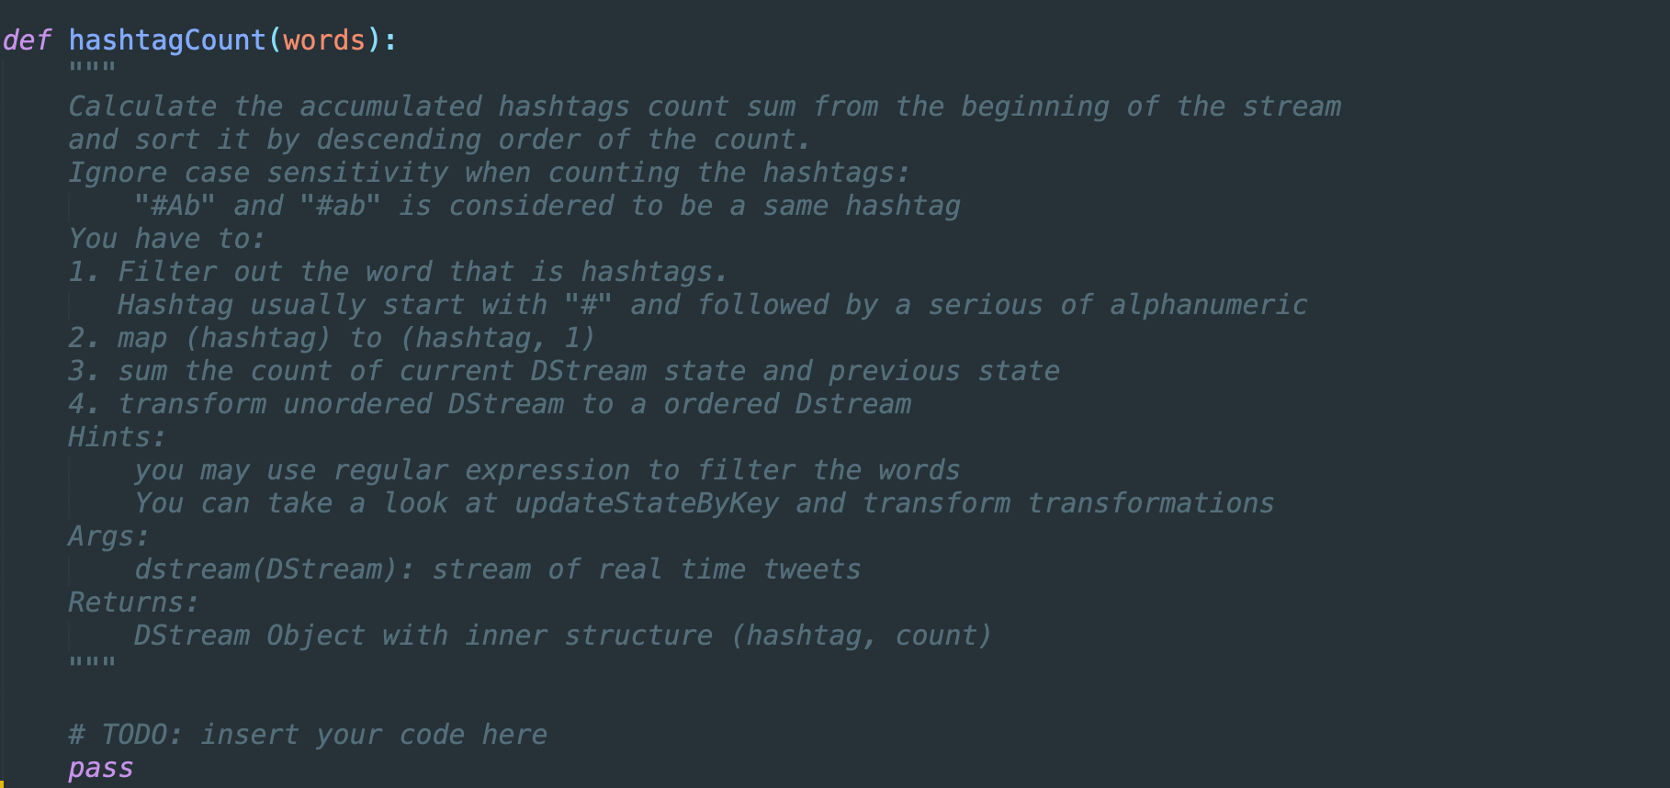
Task1: hashtagCount

Slide 25
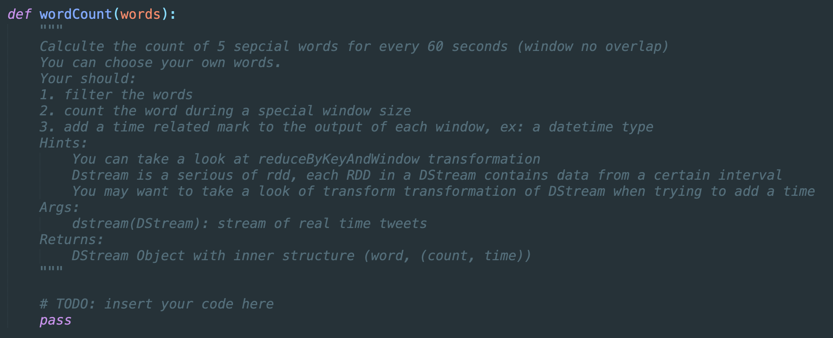
Task2: wordCount

Slide 26
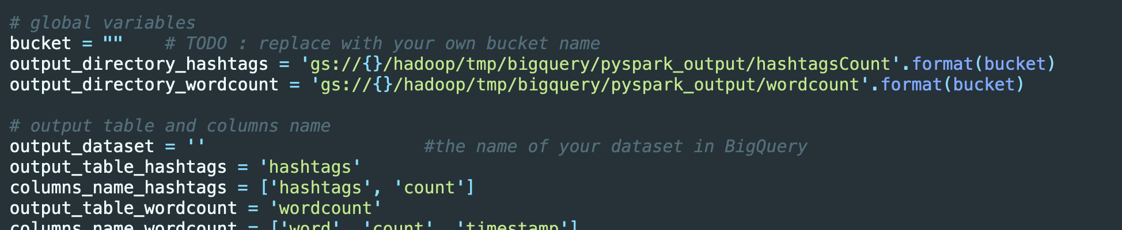
Task3: Save results
Create a dataset:
bq mk <Dataset name>
Replace with your own bucket and dataset name:

Slide 27
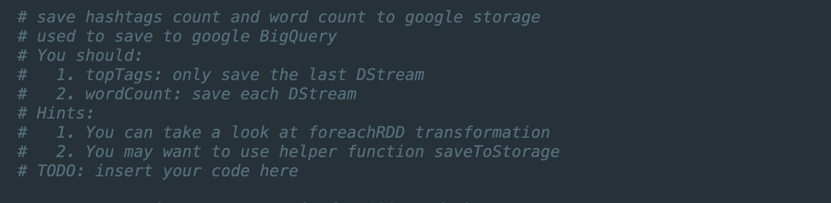
Task3: Save results

Slide 28
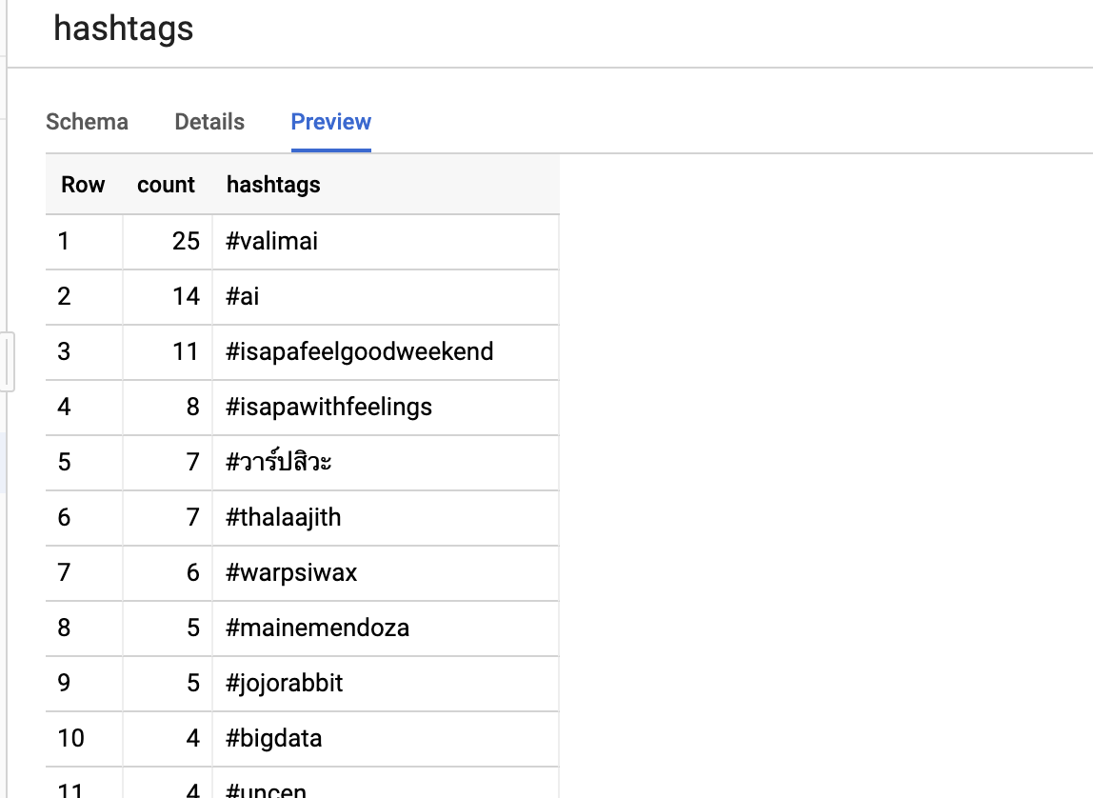
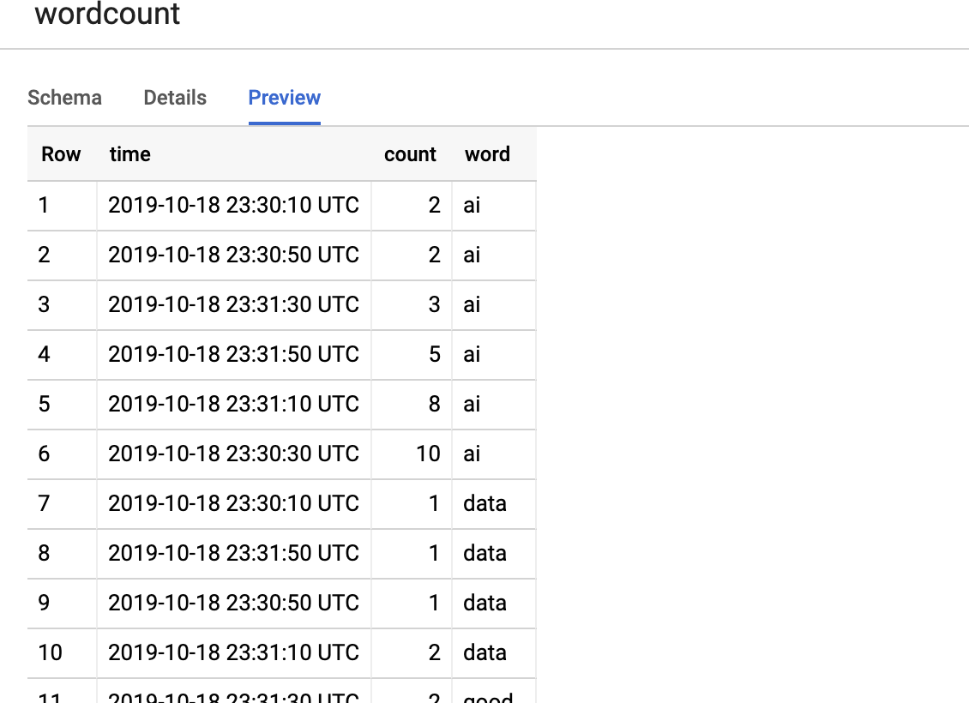
Sample Results

Slide 29
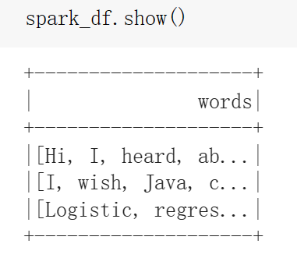
Task4: LDA Clustering
Load your streaming

Slide 30
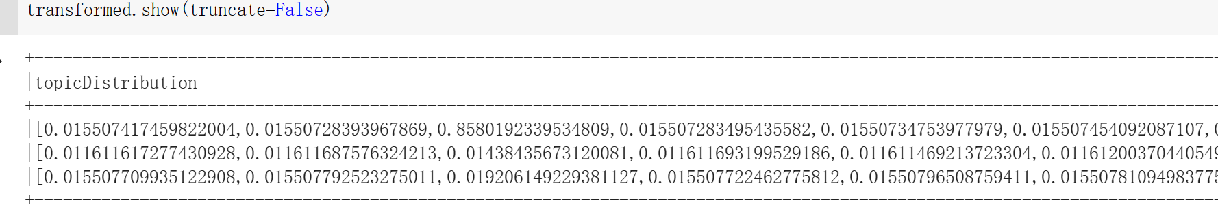
Task4: LDA Clustering
Do Clustering
Check the weight of every topic distribution

Slide 31
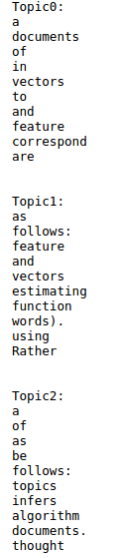
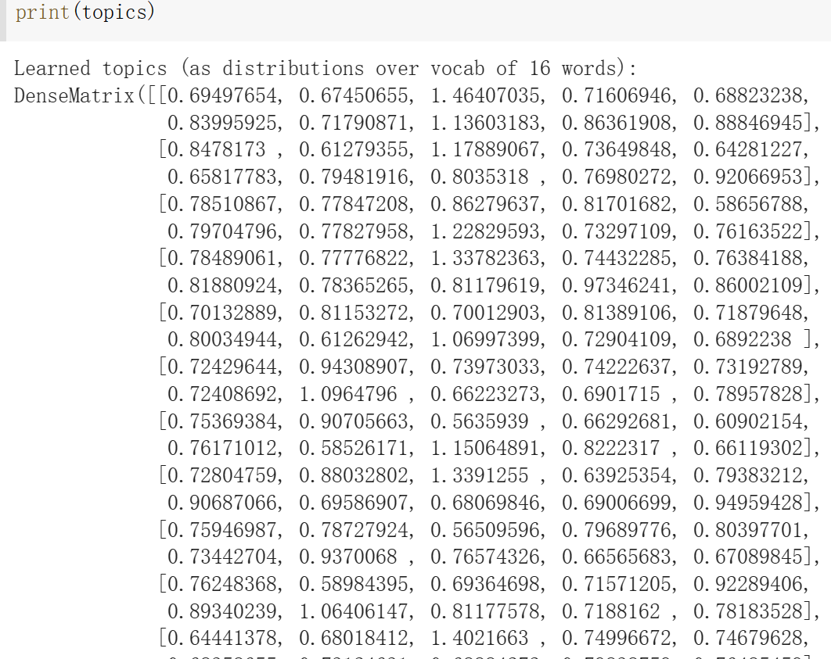
Task4: LDA Clustering
Output topic and vocabulary distribution

